Slide 1

Advancing the Use of Machine Learning in the Development of Useable Tree-Ring-Based Reconstruction of Streamflow
Madi Brake, Spencer Livingston, and Mahsa Mirzakhani
Notes:
Madi

Slide 2
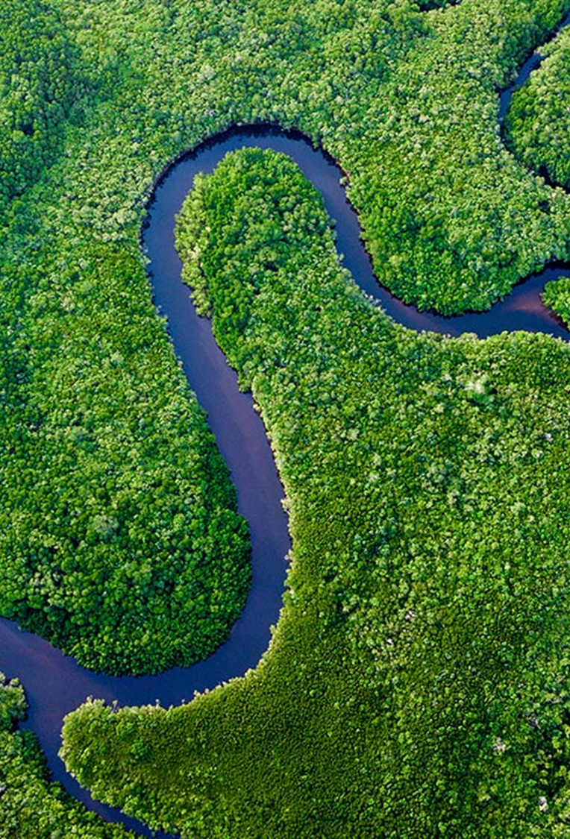
Presentation Outline
Introduction & Background
Use-Inspired Problem Statement
Data
Methods
Traditional Methods
AI / ML Methods
Evaluation & Performance Metrics
Anticipated Results
Anticipated Broader Impacts
Notes:
Madi

Slide 3
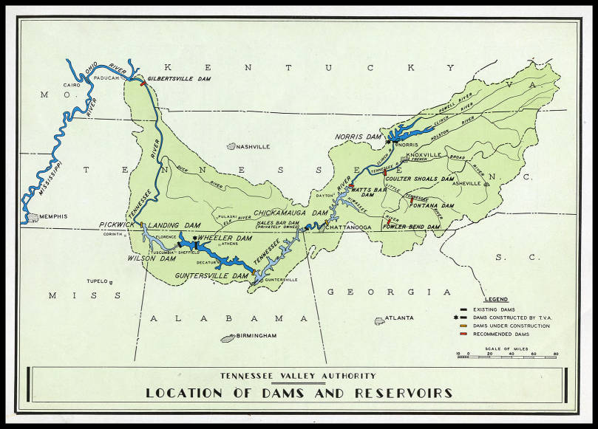
Introduction & Background
Flooding costs billions of dollars annually in the US and is expected in increase in temperate areas
Current method of predicting floods is based on historical observations
Observational data can be missing, or incomplete
Tree Rings can be a proxy combined with AI/ML and traditional regression methods to fill in gaps or reconstruct data
Spatial focus in the Tennessee Valley
Notes:
Spencer

Slide 4
Use-Inspired Problem Statement
Challenges
Short streamflow records hinder long-term trend analysis and accurate reconstructions.
Advanced AI/ML techniques haven't been fully explored for streamflow reconstruction.
Ensuring high-quality tree-ring proxy data is crucial for AI/ML success.
Goal
Extend historical streamflow records, provide past water availability information, and assist water management decisions.
Objective
Compare AI/ML/DL models with traditional methods for streamflow reconstruction in the Tennessee Valley watershed using tree-ring proxies.
Notes:
Mahsa

Slide 5
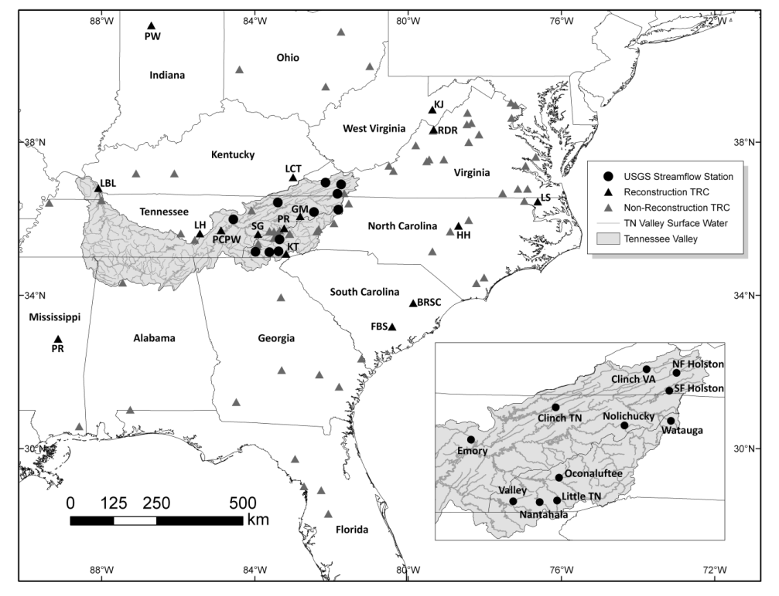
Data - Observed Streamflow
11 unimpaired USGS sites (gauges) within the Tennessee River Valley were selected for reconstruction. with an observational record ranging from around 60 to 100 years.
1920 - 2008; 1940 - 2009
Streamflow data was gathered for each site from USGS gauge data, yielding monthly mean streamflow in both cubic feet per second (flow) and million cubic meters (volume).
These monthly averages can be summed per seasonality preference of reconstructions.
To evaluate seasonality impact on streamflow reconstructions using both traditional and AI/ML techniques, we will assess the following timescales in our study:
Winter (Dec-March)
Summer (June-September)
Annual
11 Gauge Sites of Study (Source: Anderson, 2019)
Notes:
Madi

Slide 6
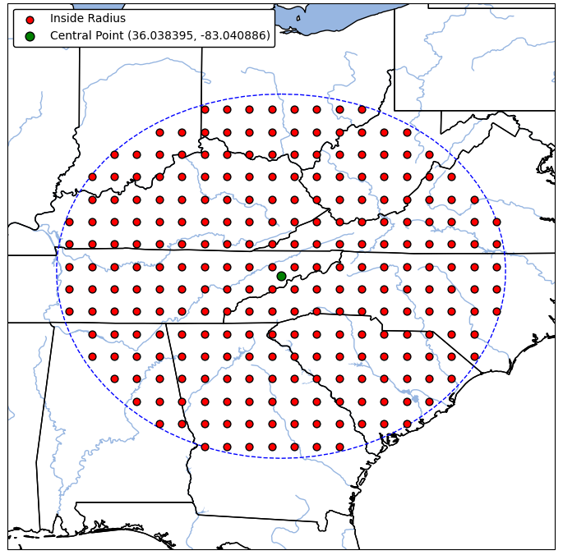
Data - PDSI Grid Points
NADA provides self-calibrating Palmer Drought Severity Index (scPDSI) grid points.
scPDSI points cover a 450-kilometer radius around the centroid of the studied stream gauges.
scPDSI values range from -4 to 4 for each year.
Robust temporal extent reaches back to 0 AD thanks to tree-ring chronologies.
Notes:
Mahsa

Slide 7
Traditional Methods
Strict Pre-screening of scPDSI Cells
Eliminate those with correlations to observed streamflow below 99%.
Ensure stable correlations throughout the overlapping period of record
Predictors and Predictand for SLR
Predictors: Pre-screened scPDSI cells (independent variables).
Predictand: Observed streamflow (dependent variable).
Stepwise Linear Regression (SLR)
Employ both forward and backward SLR techniques for reconstruction.
Bias Correction
Apply quantile mapping bias correction to each SLR-generated streamflow vector.
Notes:
Mahsa

Slide 8
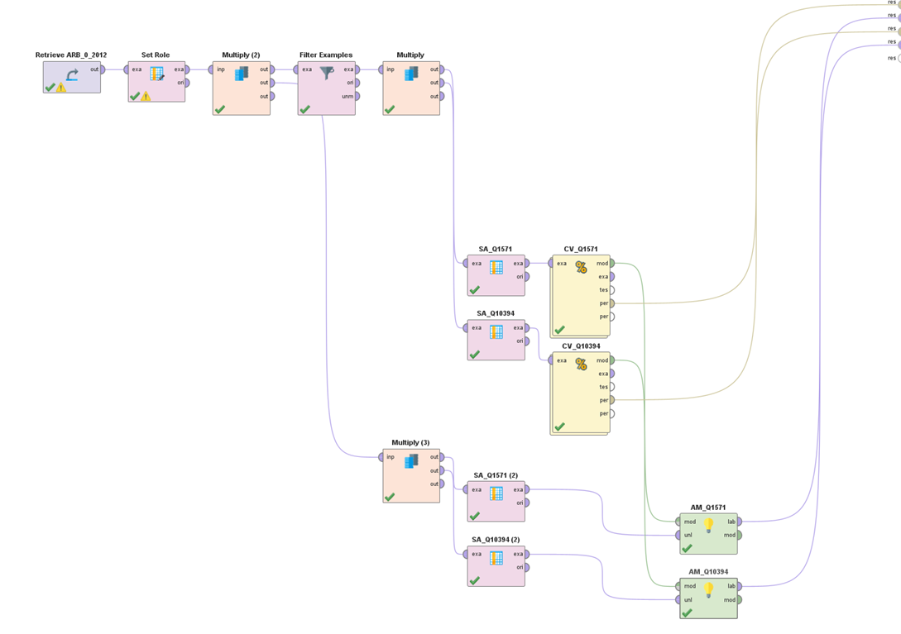
AI / ML Methods
Previous Studies:
The implementation of ML for paleo streamflow reconstructions has not been largely explored.
However, successful ML reconstructions of other climate variables have been completed in recent years.
Paleo precipitation reconstructions (Slovenia) were recently published using AI/ML/DL techniques, showing skill statistics higher than that of traditional reconstruction models (Ramirez Molina et al, 2023).
Our Research:
Novel AI/ML streamflow reconstruction methods will be employed using the no-code platform, RapidMiner Studio.
For each gauge, the instrumental record and 450-km radius scPDSI values will be utilized for training and cross-validation.
The ML algorithms used to reconstruct streamflow at each of the 11 gauges will include:
Generalized Linear Model (GLM)
Random Forest (RF)
Deep Learning (DL), and others as the research develops.
RapidMiner ML Schematic for Streamflow Reconstruction
Notes:
Madi

Slide 9
Model Performance Evaluation
The reconstruction output of the models will be compared to known historical stream records for accuracy
The AI/ML models will also be compared to more traditional methods to see if there is any improvement
Performance metrics: R^2 and RMSE
Anticipated issue: Manual computation of R^2 for bias corrected ML vectors overfits model
Further research and troubleshooting required
Notes:
Spencer

Slide 10
Anticipated Results
Traditional method outcomes should generate highly skillful streamflow reconstructions for the summer seasonality.
Due to scPDSI grid points having higher accuracy within June - September timeframe.
Our robust observational record of streamflow (60-100 years) will improve ML outputs by providing the model with more data to train and cross-validate.
As compared to Madi’s independent research in the Adige River Basin (30 years of observation, poor ML reconstruction results, low R^2 and high RMSE).
Notes:
Madi

Slide 11
Anticipated Broader Impacts
Streamflow reconstructions can be used to inform water resource management decisions by providing insights into past hydrological and climate conditions.
Stakeholders involved, including Tennessee Valley Authority, will utilize this research to:
Have longer and more complete streamflow records within the Tennessee Valley
Better optimize water resource allocation and resilience planning
Inform managers on infrastructure inspections and maintenance
Evaluate flood and drought control measurements in temporally and spatially diverse conditions
Advance understanding of modern climate events within a historical context
Explore and improve ML methodologies in hydrologic forecasting
Notes:
Mahsa and Spencer

Slide 12
References
Alfieri, L., Bisselink, B., Dottori, F., Naumann, G., de Roo, A., Salamon, P., Wyser, K., Feyen, L., 2017. Global projections of river flood risk in a warmer world. Earth’s Future 5, 171–182. https://doi.org/10.1002/2016EF000485
Anderson, S., Ogle, R., Tootle, G., & Oubeidillah, A.(2019). Tree-ring reconstructions of streamflow for the Tennessee Valley. Hydrology,6(2), 34.
Formetta, G., Tootle, G., & Bertoldi, G. (2021). Streamflow Reconstructions Using Tree-Ring Based Paleo Proxies for the Upper Adige River Basin (Italy). Hydrology,9(1), 8.
Gharib, A., & Davies, E. G. (2021). A workflow to addresspitfalls and challenges in applying machine learning models to hydrology. Advances in Water Resources, 152, 103920.
Patskoski, J., Sankarasubramanian, A., & Wang, H. (2015). Reconstructed streamflow using SST and tree-ring chronologies over the southeastern United States. Journal of Hydrology, 527, 761-775.
Ramírez Molina, A.A.; Bezak, N.; Tootle, G.; Wang, C.; Gong, J. Machine-Learning-Based Precipitation Reconstructions: A Study on Slovenia’s Sava River Basin. Hydrology 2023, 10, 207. https://doi.org/10.3390/hydrology10110207.
Ridgeway, G., Madigan, D., & Richardson, T. S. (1999, January). Boosting methodology for regression
problems. In Seventh International Workshop on Artificial Intelligence and Statistics. PMLR.
Tate, E., Rahman, M.A., Emrich, C.T., Sampson, C.C., 2021. Flood exposure and social vulnerability in the United States. Nat Hazards 106, 435–457. https://doi.org/10.1007/s11069-020-04470-2.

